Slide 1



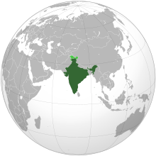


INDIAN CONSTITUTION

Slide 2

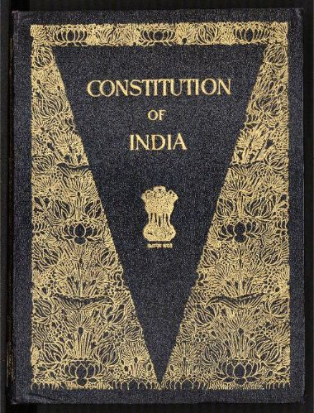
CONTENTS
1.What Is Constitution Anyway?
2.Why Do We Need Constitution?
3.The History of Constitution of India.
4.The Framing of Constitution of India.
5.The Preamble to Constitution of India.
6.What Is The constitution of India?
7.Main Characteristics of Constitution of India.
8.Conclusion
The First Book of Constitution of India is Located at Parliament Library Building, New Delhi, India.

Slide 3
CONTENTS
1.What Is Constitution Anyway?
2.Why Do We Need Constitution?
3.The History of Constitution of India.
4.The Framing of Constitution of India.
5.The Preamble to Constitution of India.
6.What Is The constitution of India?
7.Main Characteristics of Constitution of India.
8.Conclusion
The First Book of Constitution Located at Parliament Library Building, New Delhi

Slide 4



1.What Is Constitution Anyway?
Almost everything we do is governed by some set of rules. There are rules for games (like- soccer), for social clubs and for adults in the workplace. There are also rules imposed by morality and custom that play an important role in telling us what we should and should not do.
For example- In the game of soccer, a referee has "full authority to enforce the Rules or Law of the Game on the Players”, when a player do something against the Rules referee takes action like send-off a player, as shown in images below.
should
Should not
Red-card

Slide 5


1.What Is Constitution Anyway?
Some rules that are made by the legislatures (also known as Lok sabha/Rajya Sabha in India), for there own country, are called “Law”.
We need Laws in Society so our society can regulate and work properly. They are designed to protect us and our property and to ensure that everyone in society behaves the way that the community expects them too.
Laws tell us what to expect as a consequence of our actions. Laws have been the glue that has kept society together. Without laws there would be complete anarchy.

Slide 6


1.What Is Constitution Anyway?
In General-
The Constitution is the supreme law of the land. All other laws have to conform to the Constitution. The constitution contains laws concerning the government and its relations with the people.
A constitution is concerned with 2 main aspects:-
The relation between the different levels of government and
Between the government and the citizens.
Constitution
...
…
Government
The People

Slide 7
1.What Is Constitution Anyway?
Role of Constitution in relationship between Government and its people:-
CONSTITUTION
GOVERNMENT
THE PEOPLE
LEGISLATIVE
Makes Laws
JUDICIARY
Interprets Laws
EXECUTIVE
Enforces Laws
Fig.- Role of Constitution in relationship between Government and its people

Slide 8
1.What Is Constitution Anyway?
II) Technical Definitions-
A constitution is a set of fundamental principles or established precedents according to which a state or other organization is governed. These rules together make up, i.e. constitute, what the entity is. When these principles are written down into a single collection or set of legal documents, those documents may be said to comprise a written constitution.
or
The document containing laws and rules which determine and describe the form of the government, the relationship between the citizens and the government, is called a Constitution.

Slide 9
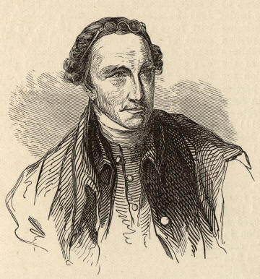
1.What Is Constitution Anyway?
III) An observation-
“The Constitution is not an instrument for the government to restrain the people, it is an instrument for the people to restrain the government.” --Patrick Henry
Patrick Henry (1736-1799)

Slide 10
CONTENTS
1.What Is Constitution Anyway?
2.Why Do We Need Constitution?
3.The History of Constitution of India.
4.The Framing of Constitution of India.
5.The Preamble to Constitution of India.
6.What Is The constitution of India?
7.Main Characteristics of Constitution of India.
8.Conclusion
The First Book of Constitution of India is Located at Parliament Library Building, New Delhi, India.

Slide 11
2.Why Do We Need Constitution?
In General-
We need a constitution to govern a country properly.
The constitution defines the nature of political system of a country.
sometimes we feel strongly about an issue that might go against our larger interests and the constitution helps us guard against this.
All the 3 organs of government (executive, legislature and judiciary) functions within the constitution. All the 3 organs of government, including ordinary citizens, derive their power and authority (i.e. Fundamental Right) from the constitution. If they act against it, it is unconstitutional and unlawful.
So constitution is required to have authoritative allocation of power and function, and also to restrict them within its limit.

Slide 12

2.Why Do We Need Constitution?

Slide 13
2.Why Do We Need Constitution?
To perform following Functions we need Constitution-
The first function of a constitution is to provide a set of basic rules that allow for minimal coordination amongst members of a society.
The second function of a constitution is to specify who has the power to make decisions in a society. It decides how the government will be constituted.
The third function of a constitution is to set some limits on what a government can impose on its citizens. These limits are fundamental in the sense that government may ever trespass them.
The fourth function of a constitution is to enable the government to fulfill the separations of a society and create conditions for a just society.

Slide 14
CONTENTS
1.What Is Constitution Anyway?
2.Why Do We Need Constitution?
3.The History of Constitution of India.
4.The Framing of Constitution of India.
5.The Preamble to Constitution of India.
6.What Is The constitution of India?
7.Main Characteristics of Constitution of India.
8.Conclusion
The First Book of Constitution of India is Located at Parliament Library Building, New Delhi, India.

Slide 15
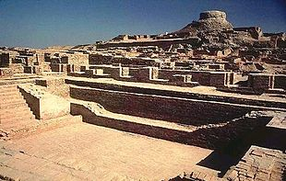

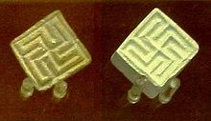
3.The History of Constitution of India.
A Look at Ancient India-
India is a home of ancient “Indus valley civilization” which goes back to 3300–1300 BC (mature period 2600–1900 BC). India is a world famous for its ancient history and culture.
Shiva Pashupati & Swastika Seals from the Indus Valley
The time Before 500 AD is widely accepted as era of Ancient India. The earliest anatomically modern human remains found in South Asia date from approximately 30,000 years ago.
But regarding to Constitutional History, India goes back to only 3rd Century BC(269 BC to 231 BC) in the time of the Emperor “Ashoka The Great.”

Slide 16
3.The History of Constitution of India.
Indian Constitutional History
Emperor Ashoka Maurya established constitutional principles, Engraved them in major rocks, pillar and on minor rocks for public to take reference. Also known as Edicts of Ashoka.
1.324 BC - 185 BC
2.1599AD-1765AD
East India Company takes total administrative control by gaining right of taxation in Bengal after Battle of Plassey (1757).
East India Company takes total unified control over the whole of India from a single center in Calcutta. But its rule ended with the Revolt of 1857.
3.1765AD-1858AD
This period of the British Raj was the time when the Constitution of India took shape.
4.1858AD-1947AD
Finally Constitution of India, created in independent India by its own free people, was adopted on 26 November 1949 and came into effect on 26 January 1950. As we know it and use it today.
5.1950AD

Slide 17
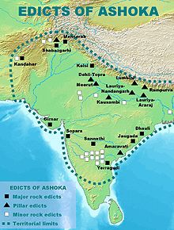
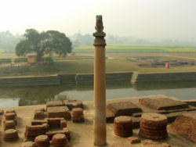

3.The History of Constitution of India.
1) The Edicts of Ashoka (324 BC - 185 BC) established constitutional principles for the 3rd century BC Maurya king's rule in Ancient India.
The Edicts of Ashoka are a collection of 33 inscriptions on the Pillars of Ashoka, as well as boulders and cave walls, made by the Emperor Ashoka of the Mauryan dynasty.
Fragment of the 6th Pillar, in Brahmi, sandstones. British Museum.
View of the Ashokan Pillar at Vaishali.

Slide 18
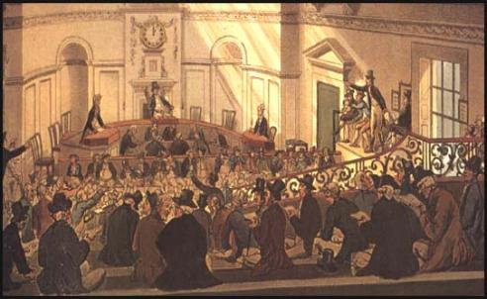
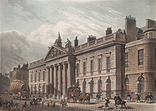
3.The History of Constitution of India.
2) East India Company (1599AD-1765AD)- In 1600, the East India Company came to India as a trading company from Britain. In 1765, it became an administrative power after gaining the Right of Taxation in Bengal after defeating the Nawab of Bengal at the Battle of Plassey (1757).
Established in 1600 by Queen Elizabeth
View of East India House

Slide 19

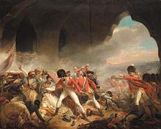

3.The History of Constitution of India.
3) East India Company (1765AD-1858AD)- During this period, the company established a unified control over the whole of India from a single center in Calcutta. Different Acts and Laws were forced by company during this period just so company could remain in power and authority. But the company came under increasing control by parliament of Britain and its rule ended with the Revolt of 1857.
Different battles all over the India.

Slide 20

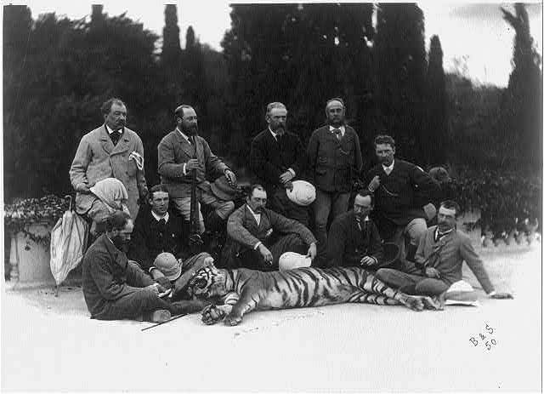
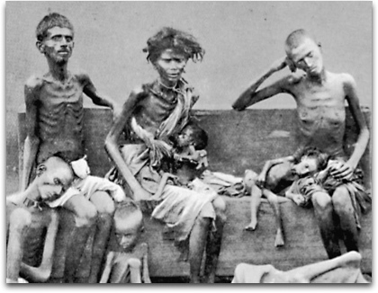
3.The History of Constitution of India.
4) British Raj(1858AD-1947AD)- This period of the British Raj was the time when the Constitution of India took shape. The main stages of its evolution were:
The Act for the Better Government of India (1858)- This put India directly under the control of the British government. It set up the office of the Secretary of State, member of the British parliament, who would be in charge of Indian government. In India, the Governor-General, working under the Secretary of State, led the administration.
Flag of British India (Known as star of India)
Left Hunting of Indian Tigers, Right Famines and epidemics in the British Raj

Slide 21
3.The History of Constitution of India.
Indian Councils Act (1861)- A separate legislative council was set up to assist the Governor-General in making laws. Indians could be appointed to the council, but only on the discretion of the Governor-General.
Indian Councils Act (1892)- As a result of Indian demands, the sizes of the executive and legislative councils were increased. More Indians were appointed to these Councils, and the principle of election was introduced.
Indian Councils Act (1909)- This act increased the sizes of the councils again, and also gave the legislative council the power to discuss certain matters and to ask questions. More people were elected to the councils.
Government of India Act (1919)- This introduced 'diarchy' (partial responsible government) at the provincial level. Elected Indians were given charge of some areas of government (e.g., industry, education) at the provincial level.

Slide 22
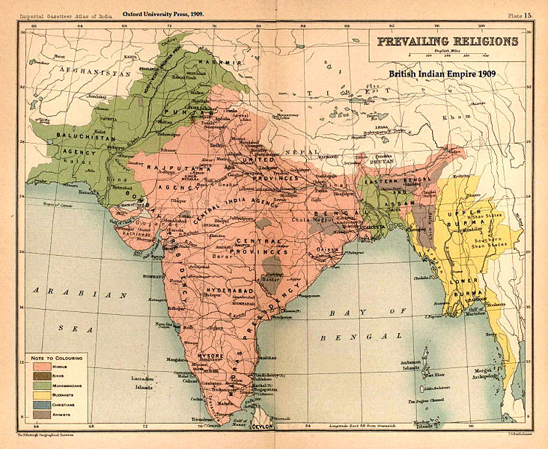
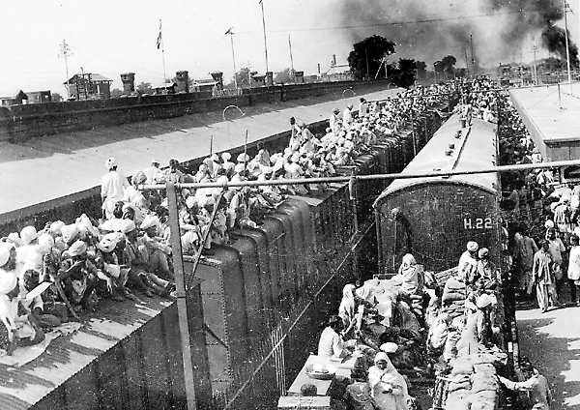
3.The History of Constitution of India.
Government of India Act (1935)- This introduced 'provincial autonomy': responsible government at the provinces with elected Indians in charge of the administration, and responsible to the elected legislatures. A federal government was proposed, though it did not come into effect. At the centre, 'diarchy' was introduced.
Indian Independence Act (1947)- The British gave up control of the Government of India to two dominions - India and Pakistan. For the time being till the constitution was made, both of them would be governed in accordance with the Government of India act 1935.
The Partition of British India was based on the prevailing religions,
broadly as shown in this map of 1909.
Photo of Refugees at railway station in Punjab

Slide 23
3.The History of Constitution of India.
5) Constitution of India(1950AD)- The Constitution was enacted by the Constituent Assembly on 26 November 1949, and came into effect on 26 January 1950.
The date 26 January was chosen to commemorate the Purna Swaraj declaration of independence of 1930. With its adoption, the Union of India officially became the modern and contemporary Republic of India and it replaced the Government of India Act 1935 as the country's fundamental governing document.
Conscious efforts were made to have consensus on different issues and principles and thereby avoid disagreement. The consensus came in the form of the ‘Objectives Resolution’ moved by Jawahar Lal Nehru in the Constituent Assembly on December 17, 1946 which was almost unanimously adopted on January 22, 1947.

Slide 24
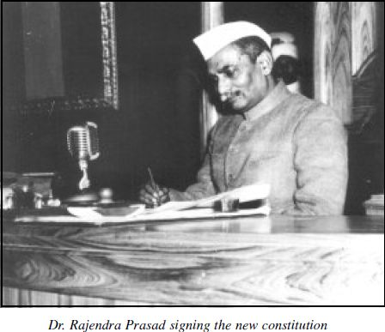
3.The History of Constitution of India.
In the light of these ‘Objectives’ the Assembly completed its task by November 26, 1949. The constitution was enforced with effect from January 26, 1950. From that day India became Republic of India.

Slide 25
CONTENTS
1.What Is Constitution Anyway?
2.Why Do We Need Constitution?
3.The History of Constitution of India.
4.The Framing of Constitution of India.
5.The Preamble to Constitution of India.
6.What Is The constitution of India?
7.Main Characteristics of Constitution of India.
8.Conclusion
The First Book of Constitution of India is Located at Parliament Library Building, New Delhi, India.

Slide 26
4.The Framing of Constitution of India.
The Constituent Assembly of India was elected to write the Constitution of India. Following India's independence from Great Britain, its members served as the nation's first Parliament.
This body was formed in 1946 for the purpose of making independent India's constitution. The assembly passed a resolution in 1947 January defining the objectives of the constitution:-
To set up a Union of India comprising British India and the princely states.
To set up a federal form of government with separate state and central governments.
To set up a democracy in which all power is derived from the people:
I) where all people are guaranteed justice, equality and freedom;
II) where minorities, depressed classes and the tribal's rights are protected;
To protect the integrity of India and her sovereign rights over land, sea and air.
To help India attain its rightful place in the world - and work for peace and welfare of all mankind.

Slide 27
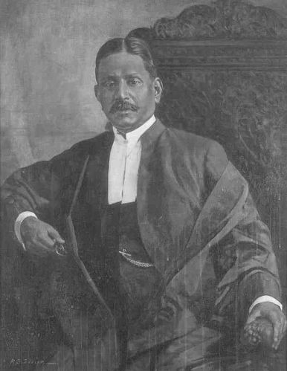
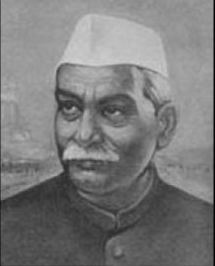
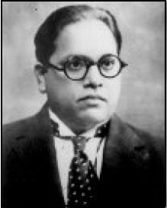
4.The Framing of Constitution of India.
Dr. Sachchidananda Sinha was the first president (temporary) of the Constituent Assembly when it met on December 9, 1946. Later, Dr. Rajendra Prasad became the President of the Constituent Assembly and Dr. Bhimrao Ambedkar became the Chairman of its drafting committee on December 11,1946 .
First president (temporary) Dr. Sachchidananda Sinha (Left) on December 9, 1946. Dr. Rajendra Prasad (Middle) the President of the Constituent Assembly and Dr. Bhimrao Ambedkar (Right) the Chairman of its drafting committee as on December 11,1946 .

Slide 28
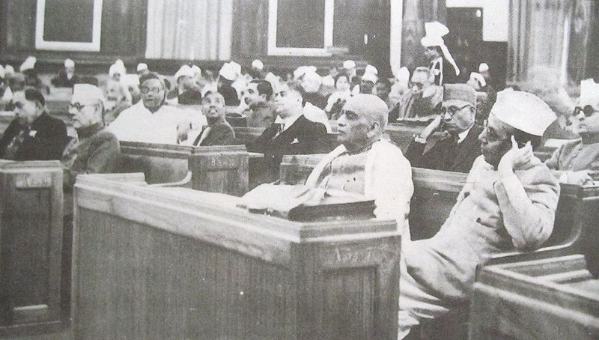
4.The Framing of Constitution of India.
The Constituent Assembly consisted of 385 members, of which 292 were elected by the elected members of the Provincial Legislative Assemblies while 93 members were nominated by the Princely States. To these were to be added a representative each from the four Chief Commissioners Provinces of Delhi, Ajmer- Marwar, Coorg and British Baluchistan.
First day (December 9, 1946) of the Constituent Assembly. From right: B. G. Kher and Sardar Vallabhai Patel;
K. M. Munshi is seated behind Patel.

Slide 29
4.The Framing of Constitution of India.
Borrowed features of constitution of India
1.From U.K. - Nominal Head – President, Cabinet System of Ministers, Post of PM, Parliamentary Type of Govt., Bicameral Parliament, Lower House more powerful, Council of Ministers responsible to Lower House, Provision of Speaker in Lok Sabha.
2.From U.S.A- Written constitution, Appointment of Vice President, Fundamental Rights, Supreme court,
Head of the state known as president, Provision of states, Judicial review
3.From Australia- Concurrent List, Centre-State relationship, Language of the Preamble
4.From USSR- Fundamental Duties, Five year plan
5.From Germany- Emergency provisions
6.From Japan- Law on which the Supreme Court functions
7.From Canada- Federal System and Residuary powers
8.From South Africa- Procedure of constitutional amendment
9.From Ireland- Concept of Directive Principles of state policy.

Slide 30
4.The Framing of Constitution of India.
For the time being till the constitution was made, India would be governed in accordance with the Government of India act 1935.
The Assembly met in sessions open to the public, for 166 days, spread over a period of 2 years, 11 months and 18 days before adopting the Constitution.
It was finally passed and accepted on Nov 26, 1949. In all the 284 members of the Assembly signed the official copies (Original) of the Indian Constitution.
After many deliberations and some modifications over 111 plenary sessions in 114 days, the 308 members of the Assembly signed two copies (Final) of the document (one each in Hindi and English) on 24 January 1950
Same day the Assembly unanimously elected Dr, Rajendra Prasad as the President of India. which came into effect on Jan 26, 1950, known and celebrated as the Republic Day of India.

Slide 31
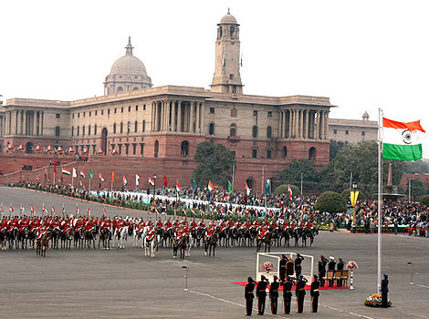

4.The Framing of Constitution of India.
The 63rd Republic Day Celebrations on 26th January 2012 at New Delhi, India

Slide 32
CONTENTS
1.What Is Constitution Anyway?
2.Why Do We Need Constitution?
3.The History of Constitution of India.
4.The Framing of Constitution of India
5.The Preamble to Constitution of India.
6.What Is The constitution of India?
7.Main Characteristics of Constitution of India.
8.Conclusion
The First Book of Constitution of India is Located at Parliament Library Building, New Delhi, India.

Slide 33
5.The Preamble to Constitution of India.
The Preamble to the Constitution of India is a brief introductory statement that sets out the guiding purpose and principles of the document.
WE, THE PEOPLE OF INDIA, having solemnly resolved to constitute India into a SOVEREIGN SOCIALIST SECULAR DEMOCRATIC REPUBLIC and to secure to all its citizens:
JUSTICE, social, economic and political;
LIBERTY of thought, expression, belief, faith and worship;
EQUALITY of status and of opportunity;
and to promote among them all
FRATERNITY assuring the dignity of the individual and the unity and integrity of the Nation;
IN OUR CONSTITUENT ASSEMBLY this twenty-sixth day of November, 1949, do HEREBY ADOPT, ENACT AND GIVE TO OURSELVES THIS CONSTITUTION.

Slide 34
5.The Preamble to Constitution of India.
The first words of the Preamble - "We, the people" - signifies that power is ultimately vested in the hands of the People of India. So far the Preamble has been amended only once in 1976 by 42nd amendment (change) which inserted the words Socialism, Secularism and Integrity. A brief description of these concepts are as follows (in the order they come in Preamble)-
Sovereign- It means free to follow internal and external Policies.
Secular- It means no particular Religion is preferred.
Socialist- It means no concentration of Power and Money.
Democratic- It means rule by elected representative of the People of India.
Republic- It means no room for hereditary ruler or monarch.

Slide 35
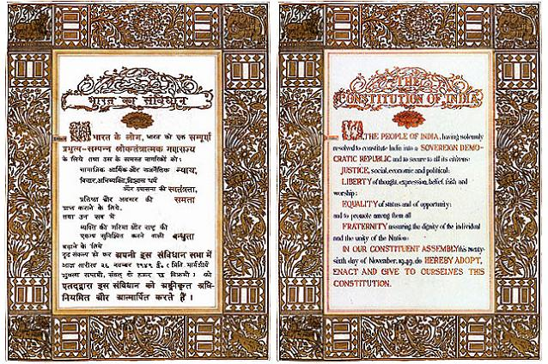
5.The Preamble to Constitution of India.
The preamble-page, along with other pages of the First and original Book of Constitution of India, was designed (Art) and decorated (Frames) solely by renowned painter Beohar shakha.
Hindi (Left) and English (Middle) versions of Preamble as available in the First book of Constitution of India (Right).

Slide 36
5.The Preamble to Constitution of India.
Purpose of Having a Preamble:
The Preamble to our Constitution serves two purposes: -
A) It indicates the source from which the Constitution derives its authority;
B) It also states the objects, which the Constitution seeks to establish and promote.
The Preamble seeks to establish what Mahatma Gandhi described as The India of my Dreams, "…an India in which the poorest shall feel that it is their country in whose making they have an effective voice; …an India in which all communities shall leave I perfect harmony. There can be no room in such an India for the curse of unsociability or the curse of Intoxicating drinks and drugs. Woman will enjoy as the same rights as man."

Slide 37
CONTENTS
1.What Is Constitution Anyway?
2.Why Do We Need Constitution?
3.The History of Constitution of India.
4.The Framing of Constitution of India
5.The Preamble to Constitution of India.
6.What Is The constitution of India?
7.Main Characteristics of Constitution of India.
8.Conclusion
The First Book of Constitution of India is Located at Parliament Library Building, New Delhi, India.

Slide 38
6.What Is The constitution of India?
(i) Constitution of India In General:-
Constitution of India is considered to be the supreme law of the country, as it puts forth the framework of fundamental political principles. It establishes the structure, procedures, powers and duties of the government and mentions the fundamental rights, directive principles and duties of citizens.
The Constitution declares India as a Sovereign, Socialist Democratic, and Republic with a parliamentary form of government.
The Indian Constitution shows Federal as well as Unitary System.
1. Federal System- powers are divided and/or shared between state and central governments
2. Union System- power concentration in central government with weak state Government

Slide 39
6.What Is The constitution of India?
Both features are listed below:-
Federal Features-
1. Supremacy of the Constitution,
2. Division of power between the Union (central Governments) and State, and
3. The existence of an independent judiciary in the Indian Constitution.
Unitary Features-
1. Single Citizenship
2. Single Constitution
3. Power of union to override on the state matters
4. During emergency the system became virtually unitary
5. Changes in the names and boundaries of the states by the Parliament
6. Integrated Judiciary System
7. Centre appoints the Governors
8. Dependence of states on the centre for economic assistance and grants.

Slide 40
6.What Is The constitution of India?
Both features are listed below:-
(ii) Structure of Constitution of India:-
The Constitution, in its current form (March 2011),
consists of 1 preamble, 25 parts containing 450 articles, 12 schedules, 2 appendices and 97 amendments to date. Although it is federal in nature it also has a strong unitary bias.
Constitution of India
Fundamental Rights
Directive Principles
Preamble
1
Parts
25
Fundamental Duties
Articles
450
Amendments
97
Schedules
12
Appendices
2

Slide 41
6.What Is The constitution of India?
Different elements of constitution are described as follows:-
1. Preamble (1) - The Preamble to the Constitution of India is a brief introductory statement that sets out the guiding purpose and principles of the document.
2. Parts (25) – The individual Articles of the Constitution are grouped together into the following Parts:
Part I – Union and its Territory
Part II – Citizenship.
Part III – Fundamental Rights.
Part IV – Directive Principles of State Policy.
Part IVA – Fundamental Duties.
Part V – The Union.
Part VI – The States.
Part VII – States in the B part of the First schedule (Repealed).
Part VIII – The Union Territories
Part IX – The Panchayats.

Slide 42
6.What Is The constitution of India?
Part IXA – The Municipalities. (Part IXB – The Cooperative Societies -not effective yet)
Part X – The scheduled and Tribal Areas
Part XI – Relations between the Union and the States.
Part XII – Finance, Property, Contracts and Suits
Part XIII – Trade and Commerce within the territory of India
Part XIV – Services Under the Union, the States.
Part XIVA – Tribunals.
Part XV – Elections
Part XVI – Special Provisions Relating to certain Classes.
Part XVII – Languages
Part XVIII – Emergency Provisions
Part XIX – Miscellaneous
Part XX – Amendment of the Constitution
Part XXI – Temporary, Transitional and Special Provisions
Part XXII – Short title, date of commencement, Authoritative text in Hindi and Repeals
3. Article (1-450) - It is subcategory of different Parts in the constitution which contains detail information of the subject or the Title which an Article represents.

Slide 43
6.What Is The constitution of India?
4. Amendments (97) - Amendment of the Constitution of India is the process of making changes to the nation's fundamental law. Changes to the Indian constitution are made by the federal parliament. The procedure is laid out in Part XX, Article 368, of the Constitution.
5. Schedules (12) - Schedules are lists in the Constitution that categorize and tabulate bureaucratic activity and policy of the Government.
6. Appendices (2) - They are extension to the constitution.
7. Fundamentals Rights (Part III- Article12-35) - The word fundamental suggests that these rights are so important that the Constitution has separately listed them and made special provisions for their protection. The Fundamental Rights are so important that the Constitution itself ensures that they are not violated by the government.

Slide 44

6.What Is The constitution of India?
Fundamental Rights are different from other rights available to us. While ordinary legal rights are protected and enforced by ordinary law, Fundamental Rights are protected and guaranteed by the constitution of the country.
The Constitution of India recognizes certain basic fundamental rights for every citizen of India, such as:-
Right to Equality
Right to Freedom
Right to Freedom of Religion
Right against Exploitation
Cultural & Educational Rights
Right to Constitutional Remedies

Slide 45


6.What Is The constitution of India?
Ordinary rights may be changed by the legislature by ordinary process of law making, but a fundamental right may only be changed by amending the Constitution itself. Besides this, no organ of the government can act in a manner that violates them.
Any infringement of fundamental rights can be challenged by any citizen of India in the court of law. The Constitution of India also prescribes some fundamental duties on every citizen in India.

Slide 46
6.What Is The constitution of India?
8. Fundamental Duties (Part IV Article 51A )- These Fundamental rights have been provided at the cost of some fundamental duties. These are considered as the duties that must be and should be performed by every citizen of India. These fundamental duties are defined as:
It shall be the duty of every citizens of India: -
To abide by the Constitution.
To uphold & protect the sovereignty, unity and integrity of India.
To Cherish & follow the noble ideas which inspired our national struggle for freedom
To defend the country & render national service when called upon to do so.
To promote harmony & the spirit of common brotherhood.
To value & preserve the rich heritage of our composite culture.
To protect & improve the national environment.
To develop the scientific temper, humanism and the spirit of inquiry and reform.
To safeguard public property & to abjure violence.
To strive towards excellence in all spheres of individual & collective activity, so that the nations constantly rises to higher levels of endeavor & achievement.

Slide 47
6.What Is The constitution of India?
9. Directive Principles (Part IV- Article36-51)- It provides the social and economic base of a genuine democracy. The classification of these are as follows-
Socio-economic Principles
Liberal Principles
Gandhian Principles
International principles
1. Socio-economic Principles
1. Article 38 of the Constitution of India shall endeavor to formulate such social system which will secure social, economic and political justice to all in all the spheres of life.
2. Article 39(a) the state shall try to formulate its policy in such a manner so as to secure adequate means of livelihood for all its citizens.
3. Article 39(b) the ownership of material resources would be controlled in such a manner so as to sub serve the common good.
4. Article 39(c) the economy of the state will be administered in such a manner so that wealth may not yet be concentrated in a few hands and the means of production may not be used against the public interest.

Slide 48
6.What Is The constitution of India?
5. Article 41 of the Indian Constitution, the State will work within the limits of its economic viability and progress, provide to the citizens the right to work, the right to education and general assistance in the event of unemployment, old age, disease and other disabilities.
6. Article 42 of the Indian Constitution, the state will make provisions for the creation of just and humane conditions of work. It will also ensure maternity relief.
7. Article 43 of the Indian Constitution, the state will ensure adequate wages, good life and rest to the laborers. The state will also endeavor to make available to the laborers various sociocultural facilities.
2. Liberal Principles
Article 44 of the Indian Constitution, the State shall endeavor to formulate and implement a Uniform civil-code for all the people living throughout the territory of India.
Article 45 of the Indian Constitution, the State shall endeavor to provide early childhood care and education for all the children until they complete the age of six years.
Article 47 of the Indian Constitution, the State shall strive to raise the level of nutrition and the standard of living. Thus, it will endeavor to improve upon the health of the people.
Article 48 of the Indian Constitution, the State shall strive to organize agriculture and husbandry on modern and scientific lines. It will also try to maintain and improve upon the breed of the animals.

Slide 49
6.What Is The constitution of India?
5. Article 50 of the Indian Constitution the state will try to separate the judiciary from the executive in the case of public service.
3. Gandhian Principles
Article 40, State will strive to organize Panchayats in villages and will endow them with such powers which enable them to act as units of self government.
Article 43, the state shall strive to develop the cottage industry in the rural areas both, on individual or cooperative basis.
Article 47,the state will strive to ban the consumption of wine, other intoxicating drinks and all such commodities which are considered injurious to health.
Article 48 reveals that State will ban slaughtering of cows, calves and other milk cattle.
4. International principles
Article 51(a)- The State will strive to promote international peace and security.
Article 51(b)- The State will strive to maintain just and honorable relations among various states in the world.
Article 51(c)- The State will endeavor to promote respect for International treaties, agreements, and law.
Article 51(f )- The State will strive to settle international disputes by arbitration.

Slide 50
6.What Is The constitution of India?
(iii) Constitution of India and Government:-
The Indian government is divided
Into three distinct but interrelated branches: Legislative, Executive and Judiciary – have to function within their own spheres demarcated under the Constitution. In other words, the doctrine of Separation of Powers has been implicitly recognized by the Indian Constitution.
Government of India
Legislative
Judiciary
Executive
The Parliament of India =the President of India + the two Houses
Lok Sabha (House of the People) and Rajya Sabha (Council of States).
The Supreme Court of India consists of a Chief Justice and 30 associate justices
The President of India, Vice President, Cabinet, executive departments and agencies.

Slide 51
6.What Is The constitution of India?
(iv) The Basic Principles of the Constitution of India:-
A careful study of the Constitution will show that there are at least eight basic principles which are embodied in it and which form the foundation of the political system in India. These are:
(1) Popular sovereignty,
(2) Socialism,
(3) Secularism,
(4) Fundamental rights,
(5) Directive Principles of State Policy,
(6) Judicial independence,
(7) Federalism and
(8) Cabinet government.

Slide 52
6.What Is The constitution of India?
(v) Procedure of Amendments of the Constitution of India:-
The basic structure of the Constitution is unchangeable and only such amendments to the Constitution are allowed which do not affect its basic structure or rob it of its essential character.
By simple majority of the Parliament: Amendments in this category can be made by a simple majority of members present and voting, before sending them for the President's assent.
By special majority of the Parliament: Amendments can be made in this category by a two - third majority of the total number of members present and voting, which should not be less than half of the total membership of the house.
By special majority of the Parliament and ratification of at least half of the state legislatures by special majority. After this, it is sent to the President for his assent.

Slide 53

6.What Is The constitution of India?
An amendment to the “Constitution of India” is an extremely difficult affair, and normally needs at least “two-thirds(2/3)” of the Lok Sabha and Rajya Sabha to pass it.
However, the Constitution of India is one of the most frequently amended constitutions in the world. Many matters that would be dealt with by ordinary statutes in most democracies must be dealt with by constitutional amendment in India due to the document's extraordinary detail.

Slide 54

6.What Is The constitution of India?
(vi) Checks and Balances:-
The Indian Supreme Court and Election Commission are recognized as the bedrock of Indian democracy; these two bodies stand up to the enormous powers that the constitution invests in the central government in general and to the unbridled powers of the Indian prime minister in particular.
The checks and balances that are provided by the constitution also smooth out the strained relations between the central government and the states by limiting the central government's ability to interfere in the states' affairs. Usually, either the state government or a political party may file an appeal or a writ petition in the Supreme Court against a policy or practice of the union or a state.

Slide 55
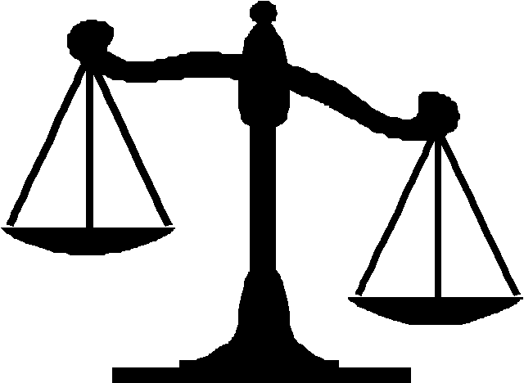
6.What Is The constitution of India?
Although India's constitution follows the British parliamentary system, it is the constitution and not the parliament of India that reigns supreme. As in the United States, the Indian courts interpret the constitution and adjudicate the laws passed by the parliament.
Although the parliament has the authority to amend the constitution, India's courts have made sure that the parliament does not change its fundamental structure, which guarantees economic opportunities, social justice, and religious and political freedom to all its citizens. Although political corruption and coercion are rampant in India—as they are in other developing countries—the courts are judiciary guarantors of India's freedom from oppression.

Slide 56
CONTENTS
1.What Is Constitution Anyway?
2.Why Do We Need Constitution?
3.The History of Constitution of India.
4.The Framing of Constitution of India
5.The Preamble to Constitution of India.
6.What Is The constitution of India?
7.Main Characteristics of Constitution of India.
8.Conclusion
The First Book of Constitution of India is Located at Parliament Library Building, New Delhi, India.

Slide 57
7.Main Characteristics of Constitution of India.
The Constitution of India has some distinct and unique features as compared to other constitutions to the world. As Dr. B.R. Ambedkar, the Chairman of the Drafting Committee puts it, the framers had tried to accumulate and accommodate the best features of other constitutions, keeping in view the peculiar problems and needs of our country. Main Characteristics of Constitution of India are:-
Longest written constitution.
Partly Rigid and Partly Flexible
A Democratic Republic
Parliamentary System of Government
A Federation
Fundamental Rights
Directive Principles of State Policy
Fundamental Duties
Secular State
An Independent Judiciary
Single Citizenship

Slide 58
CONTENTS
1.What Is Constitution Anyway?
2.Why Do We Need Constitution?
3.The History of Constitution of India.
4.The Framing of Constitution of India
5.The Preamble to Constitution of India.
6.What Is The constitution of India?
7.Main Characteristics of Constitution of India.
8.Conclusion
The First Book of Constitution of India is Located at Parliament Library Building, New Delhi, India.

Slide 59
8.Conclusion
A Constitution symbolizes independence of a country. Framework and structure for the governance of a free country are provided in the Constitution. The Constituent Assembly prepared the draft of the Constitution by keeping the ‘Objectives Resolution’ as the backdrop which reflected the aspirations of the people of India.
The framing of the Constitution was completed on November 26, 1949 when the Constituent Assembly formally adopted the new Constitution. The Constitution came into force with effect from January 26, 1950.
The Constitution begins with a Preamble which declares India to be a Sovereign, Socialist, Secular, Democratic, Republic. The Preamble also mentions the goals of securing justice, liberty and equality for all its citizens and promotion of natio-nal unity and integrity on the basis of fraternity among the people assuring dignity of the individual.

Slide 60
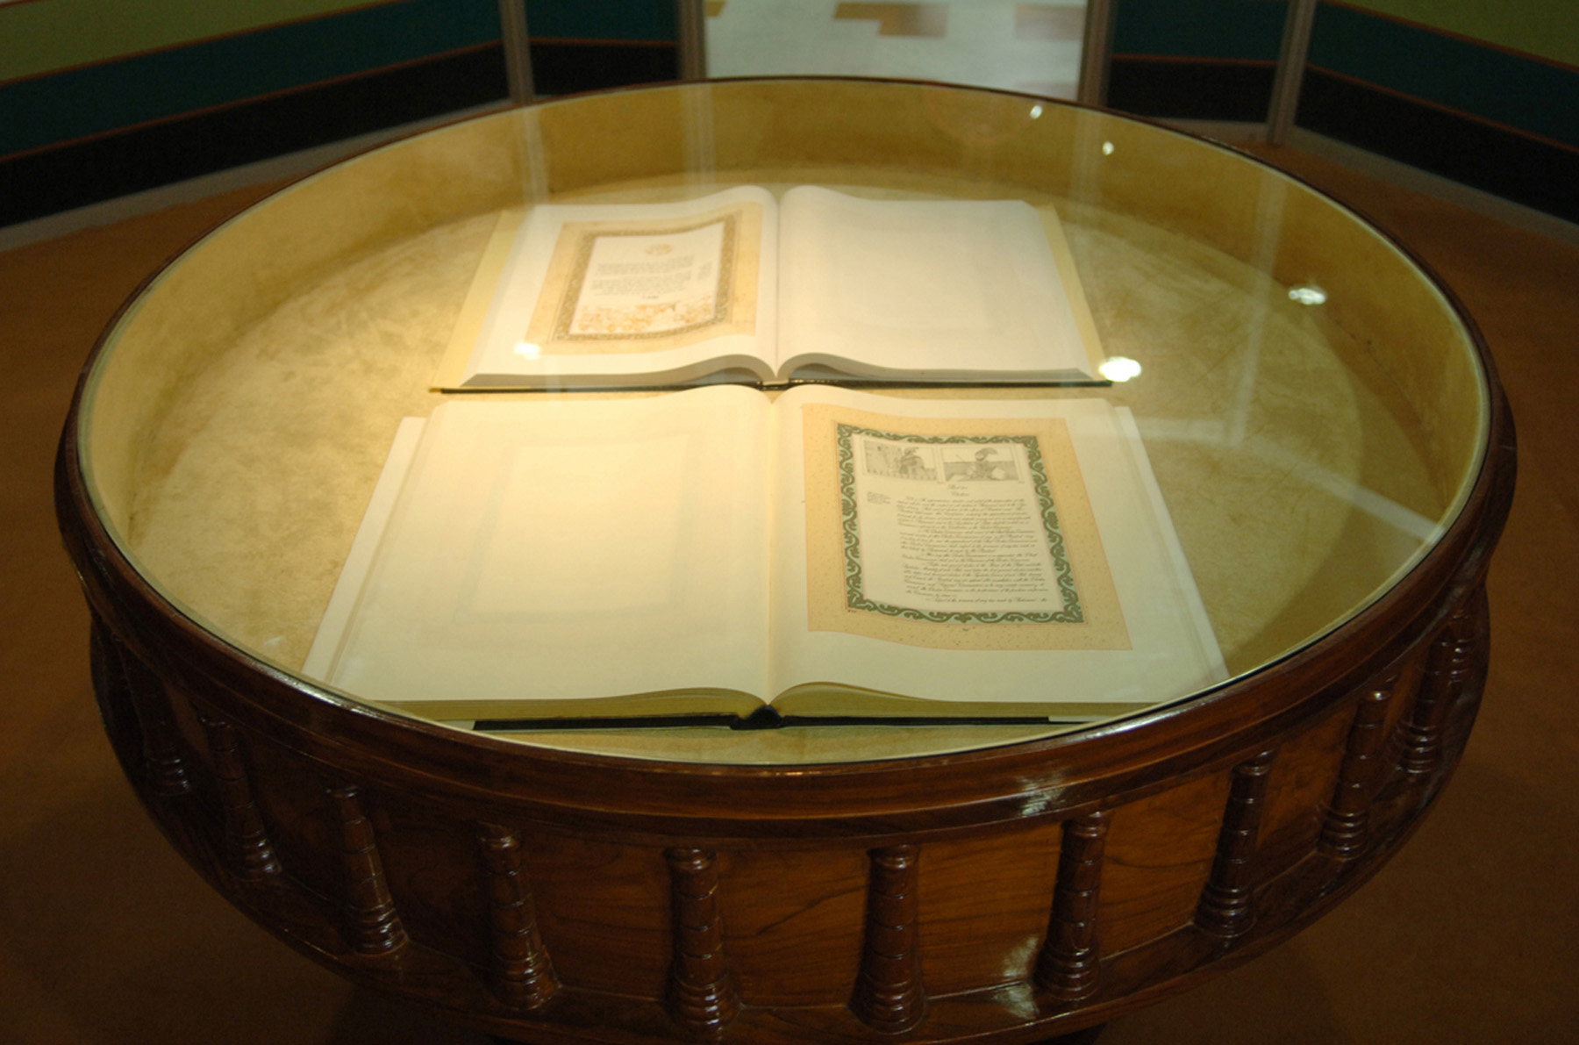
8.Conclusion
Picture shows the pages from the Constitution of India, at the PARLIAMENT MUSEUM, Parliament Library Building, New Delhi.
PARLIAMENT MUSEUM : A high-tech story-telling Museum depicting the continuum of the democratic heritage in India has been dedicated to the Nation by
Dr. A P J Abdul Kalam, President of India on 14th August 2006.

Slide 61
8.Conclusion
The Constitution of India has several distinctive features. It is the lengthiest Constitution in the world and it is a combination of rigidity and flexibility. The Constitution provides for a quasi-federal (It means a federal set up where despite having two clear sets of government – central and the states, more powers are given to the Central Government.) set up with a strong centre.
There is a clear division of powers between the Centre and the States. The Supreme Court of India, is the apex court of India which will resolve the disputes between the centre and state or between the states.
India has a parliamentary democracy. The Council of Ministers headed by the Prime Minister enjoys the real powers and is responsible to the Parliament. The Indian Constitution provides for Fundamental Rights which are justifiable. Ten Fundamental Duties have also been added to the Constitution. The Directive Principles of State Policy give a concrete shape to the welfare concept.

Slide 62
8.Conclusion
It is time to undertake a study of Indian Federalism with a view to valuate the trends, frictions and difficulties which have developed in the area of inter-governmental relations and to seek to evolve ways and means to meet the challenging task of making the Indian federation a more robust, strong and workable system so that the country may meet the tasks of self-improvement and development.
The responsibility lies on not only the jurists and policy framers, but also the citizens of the country to work in a harmonious manner for the development of the country.

Slide 63
CONTENTS
1.What Is Constitution Anyway?
2.Why Do We Need Constitution?
3.The History of Constitution of India.
4.The Framing of Constitution of India
5.The Preamble to Constitution of India.
6.What Is The constitution of India?
7.Main Characteristics of Constitution of India.
8.Conclusion
The First Book of Constitution of India is Located at Parliament Library Building, New Delhi, India.

